Slide 1
Ectoparasitosis
Sucking Lice (Anoplura)
Detailed Morphology, Life Cycle, and Medical Importance

Slide 2
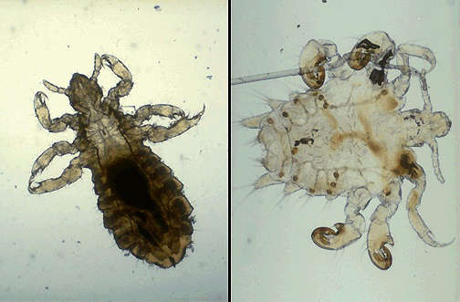
Pediculus humanus – Morphology
Body lice are dorsoventrally flattened, wingless insects measuring 2.3–3.6 mm.
They have elongated bodies, well-developed claws for
grasping clothing fibers,
and piercing-sucking
mouthparts adapted
For blood feeding.

Slide 3
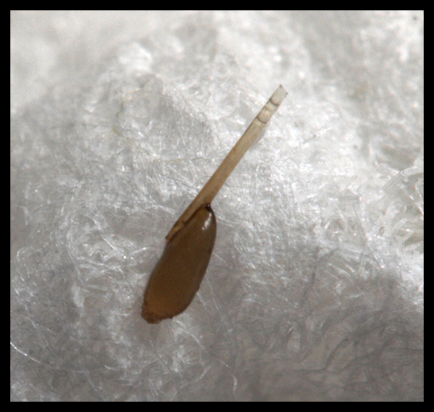
Pediculus humanus – Life Cycle
Eggs (nits) are laid on clothing seams. Nymphs hatch in 6–10 days and undergo three molts to become adults.
The entire cycle takes around
2–3 weeks.
Lice survive only a few days without a host.

Slide 4
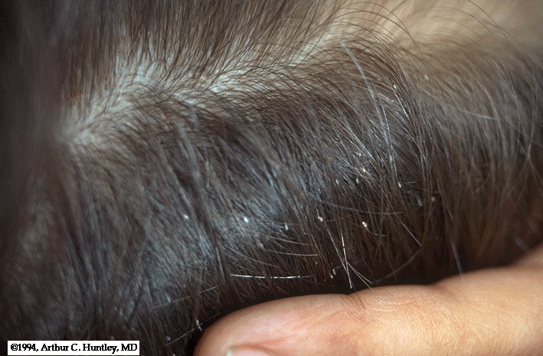
Pediculus humanus – Medical Importance
These lice transmit diseases such as epidemic typhus (Rickettsia prowazekii), trench fever (Bartonella quintana), and relapsing fever (Borrelia recurrentis).
Infestations are common in
overcrowded, unhygienic
environments.

Slide 5
Pediculus capitis – Morphology
Head lice are similar in shape and size to body lice but adapted to live among scalp hair.
They are smaller and have claws adapted to grasp hair shafts.
They are pale grey and become reddish after feeding.

Slide 6
Pediculus capitis – Life Cycle
Females lay eggs on hair shafts close to the scalp.
Nymphs hatch in 7–10 days and develop into adults through three molts over 9–12 days.
Adults live about 30 days, feeding frequently on blood.

Slide 7
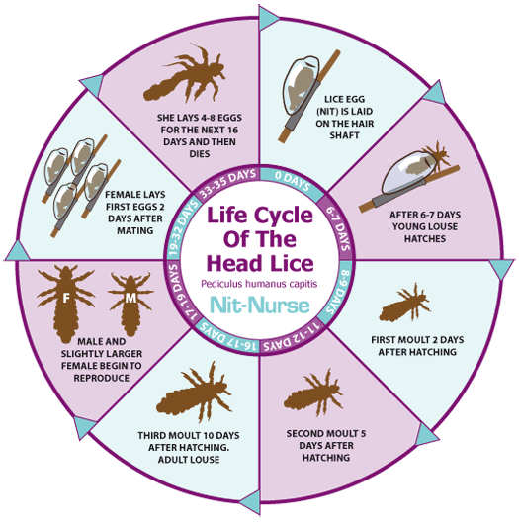
Life Cycle

Slide 8
Pediculus capitis – Medical Importance
Head lice are not known to transmit diseases but can cause intense pruritus and secondary bacterial infections from scratching.
Infestations are most common among school-aged children.

Slide 9

Pthirus pubis – Morphology
Pubic lice are smaller (1.1–1.8 mm), crab-shaped, with broad bodies and large claws adapted for coarse hair.
They are usually found
in the pubic area but
can also infest other
hairy areas.

Slide 10
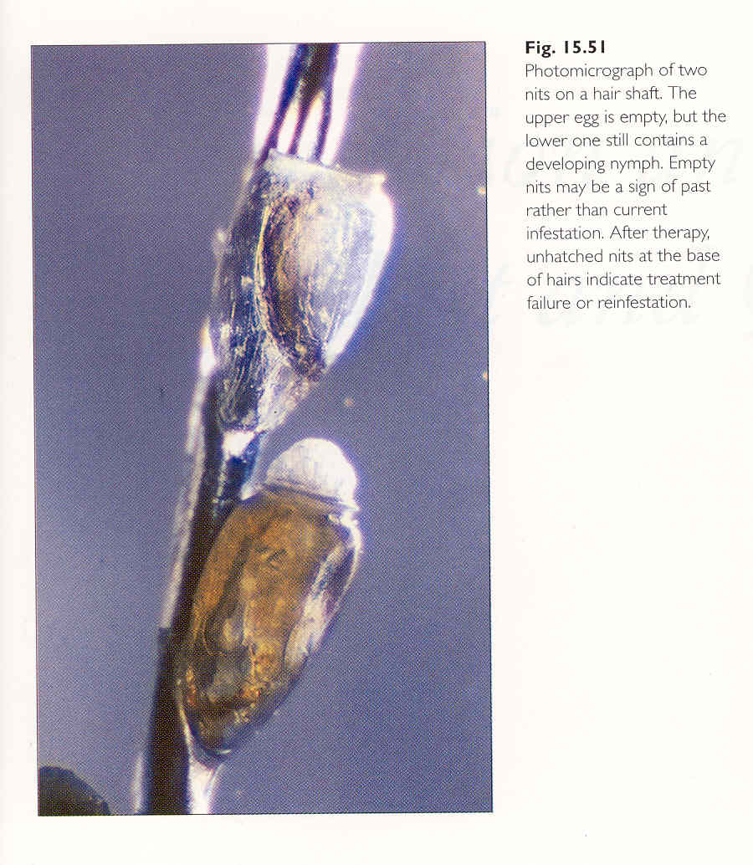
Pthirus pubis – Life Cycle
Females lay eggs on coarse body hair.
Nymphs hatch in about 6–10 days and mature in 2–3 weeks.
The life span is approximately 30 days, with frequent blood meals.

Slide 11
Pthirus pubis – Medical Importance
Pubic lice infestations cause itching, irritation, and visible lice/nits.
They are typically spread through sexual contact.
Unlike head and body lice, pubic lice do not transmit pathogens.

Slide 12
Comparison of Treatments for Head Lice, Body Lice, and Pubic Lice
Type of Lice | Affected Area | Common Symptoms | Medical Treatment | Supportive & Home Remedies
Head Lice | Scalp and hair | Intense itching, visible nits | Permethrin shampoo, Lindane shampoo | Fine-tooth combing, washing personal items
Body Lice | Skin and clothing | Itching, skin sores | Permethrin cream, Malathion lotion | Hot washing clothes, regular bathing
Pubic Lice | Genital area | Itching, redness, visible lice | Permethrin cream, Piperonyl butoxide lotion | Shaving affected area, washing clothes and bedding

Slide 13
Control
Lice control involves maintaining good personal hygiene, regular hair washing, and avoiding sharing personal items like combs, hats, or bedding.
In outbreak situations, treatment of affected individuals and their close contacts with pediculicides is essential to prevent reinfestation.

Slide 14
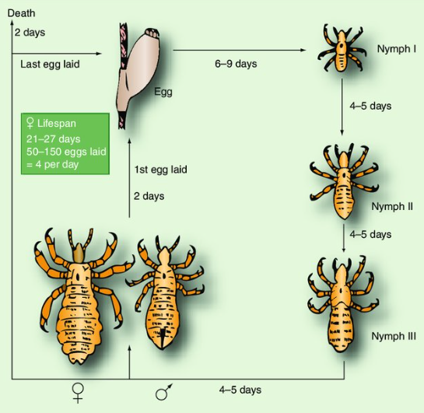

Slide 15
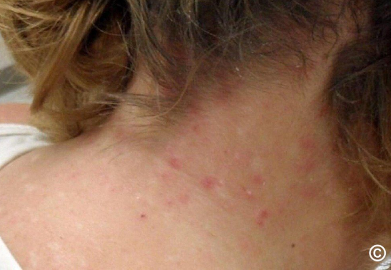

Slide 16
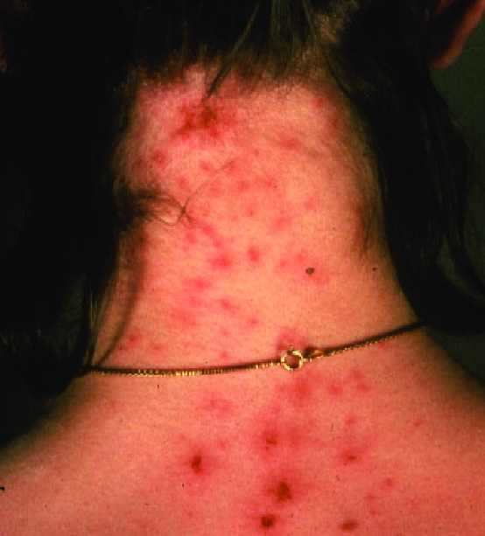

Slide 17
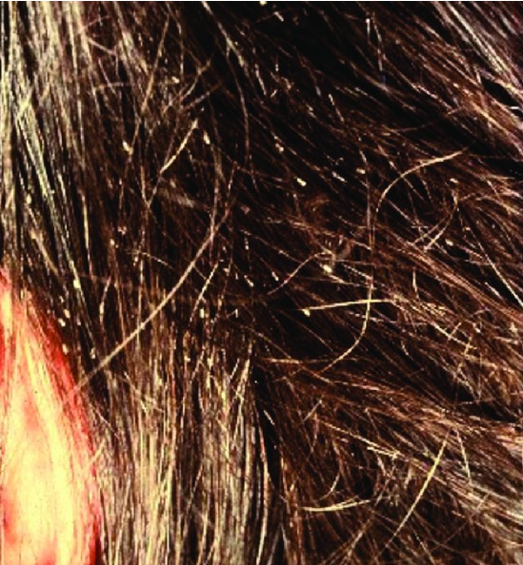

Slide 18
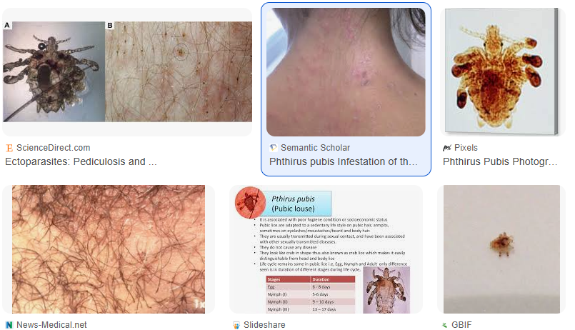
Phthirus pubis

Slide 19
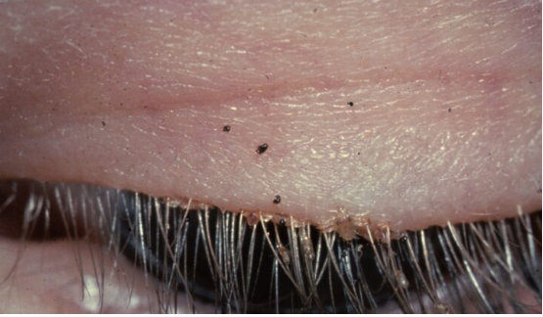
Phthirus pubis on eyelash

Slide 20
Scabies Mites (Sarcoptidae)
Morphology, Life Cycle, Recognition, Treatment, and Control

Slide 21
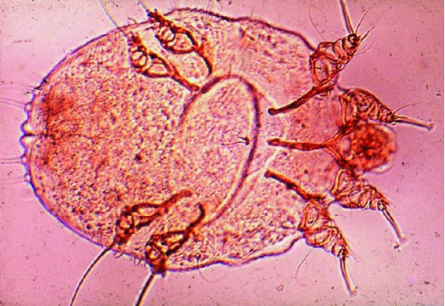
18.1 External Morphology
Scabies mites are tiny (0.2–0.4 mm), round, and flattened arachnids. They have short legs with sucker-like structures and are not visible to the naked eye.
The body is covered
with fine setae and
spines for burrowing
through skin.

Slide 22
Life Cycle
The life cycle includes egg, larva, nymph, and adult stages. Female mites burrow into the skin to lay eggs.
Larvae hatch and develop into nymphs and adults on the skin surface.
The entire cycle takes about 2–3 weeks.

Slide 23
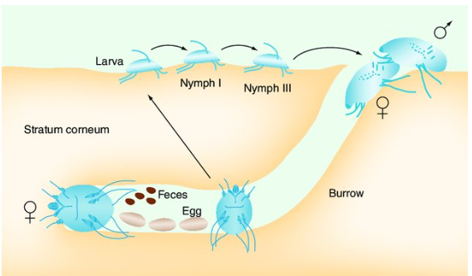
Life cycle of Scabies Mites

Slide 24
Recognition of Scabies
Scabies is recognized by intense itching, especially at night, and the presence of burrows—thin, wavy, raised lines on the skin.
Commonly affected areas include hands, wrists, elbows, and waist.
Diagnosis may involve skin scraping.

Slide 25
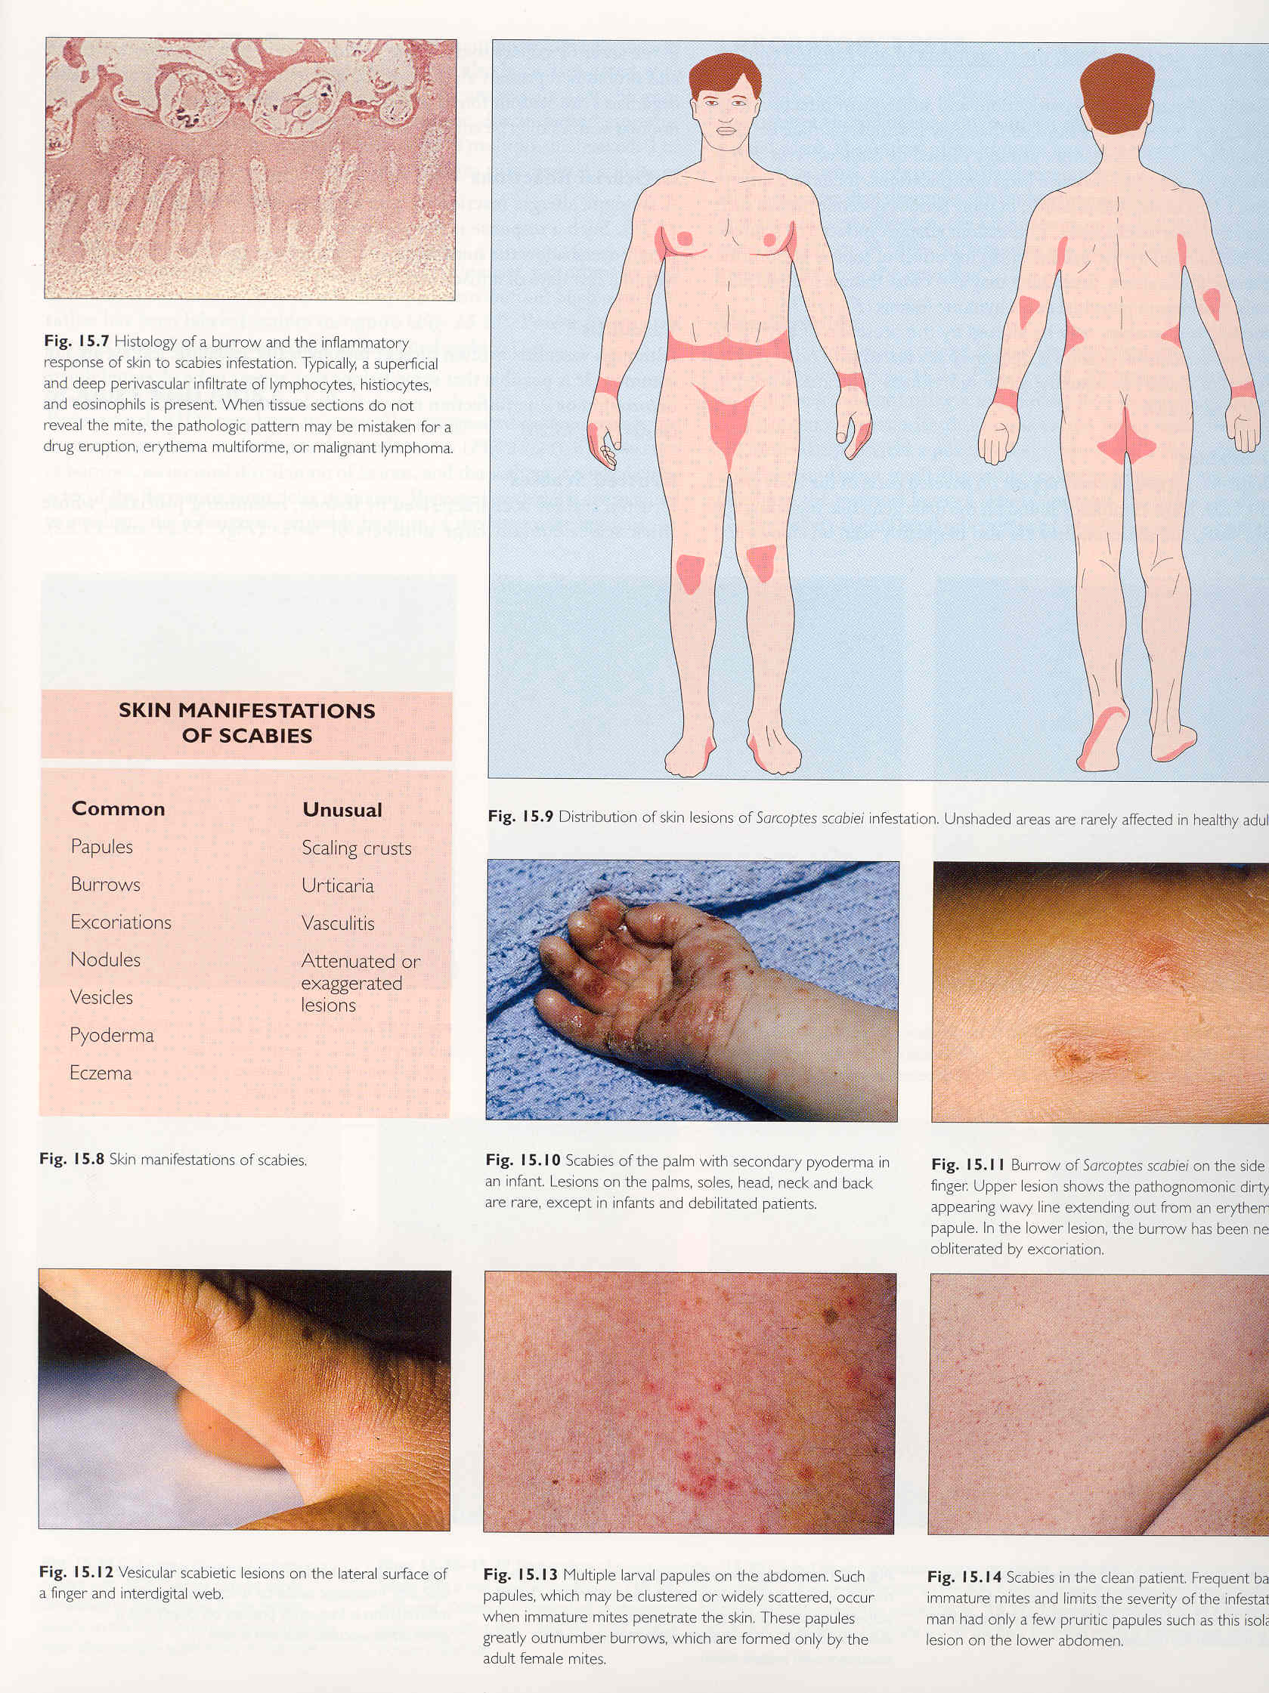

Slide 26
Treatment of Scabies
Treatment includes topical scabicides like permethrin 5% cream or oral ivermectin.
All close contacts should be treated simultaneously.
Itching may persist post-treatment due to allergic reactions.

Slide 27
Control
Control measures involve treating affected individuals and their contacts, washing clothing and bedding in hot water, and maintaining personal hygiene.
Outbreaks in institutions require prompt identification and coordinated response.

Slide 28
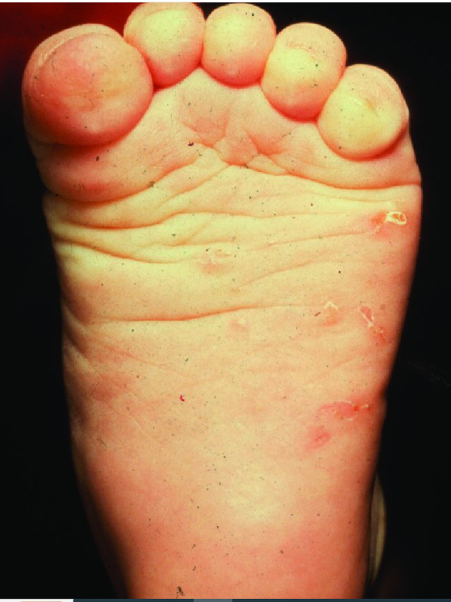
Scabies burrows on the feet of an infant.

Slide 29
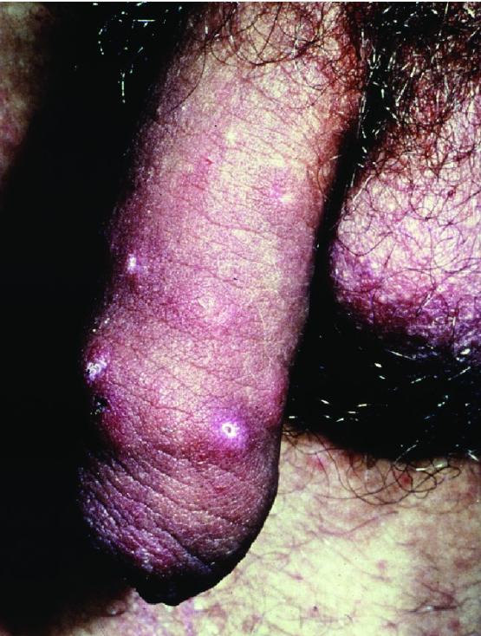
Scabies burrows on the penis of an infested patient.

Slide 30
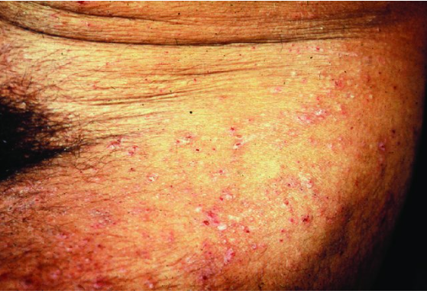
Scabies rash seen around the waist and thighs.

Slide 31
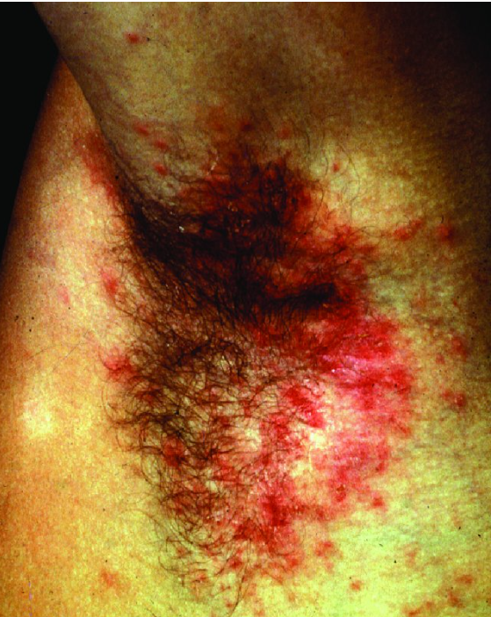
Skin rash on the axilla of a patient with scabies.

Slide 32
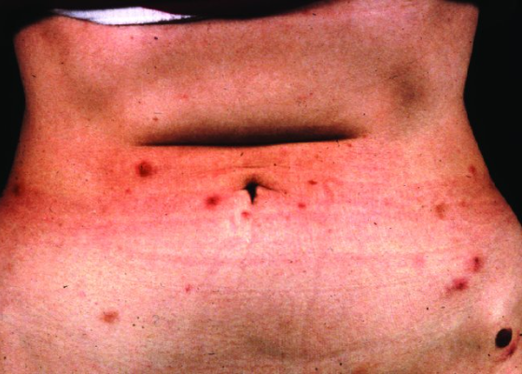
Nodular scabies
Nodular scabies. Nodular lesions are seen in approximately 7% of patients with scabies. The lesions (5-8 mm in diameter) appear during active scabies infestation and can been seen weeks after a successful treatment.

Slide 33
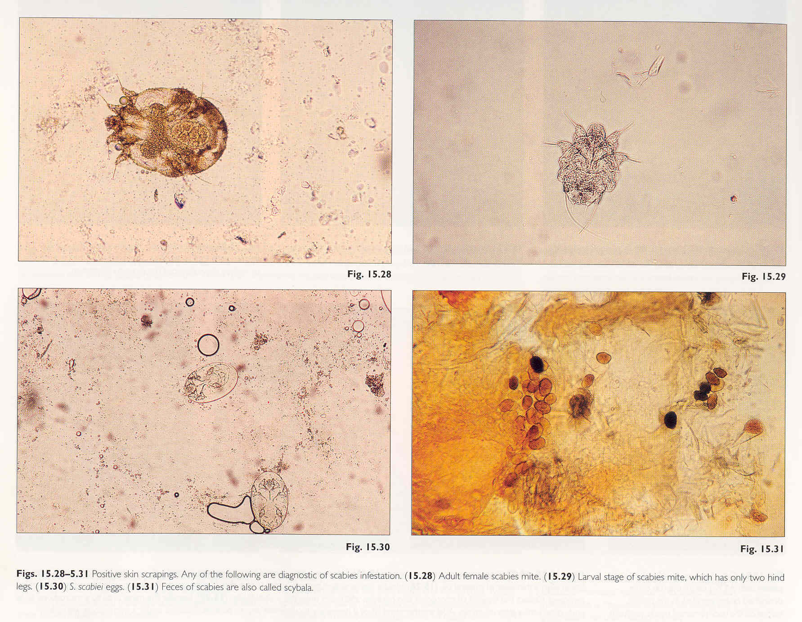
Microscopic observations (eggs - adult parasites) in skin scrapings

